Slide 1
Alternakraft Project Overview

Slide 2
Overview
Alternakraft is a nonprofit organization that wishes to accumulate data regarding households in the United States,
specifically around alternative power sources and other household properties. The data collected will be “open” in the
sense that anyone will be able to submit their data. Conversely, anyone can browse the selected set of reports available
on the Alternakraft website.

Slide 3
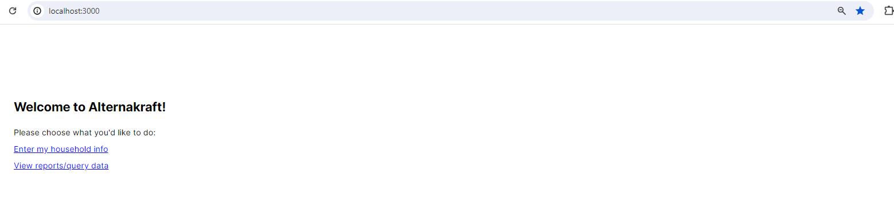

Slide 4
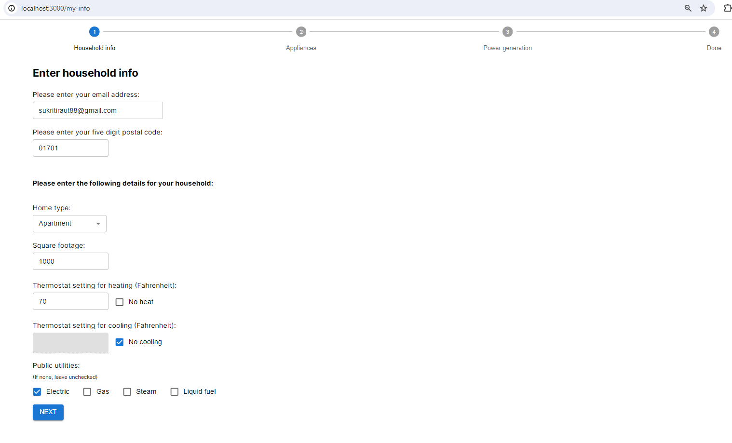

Slide 5
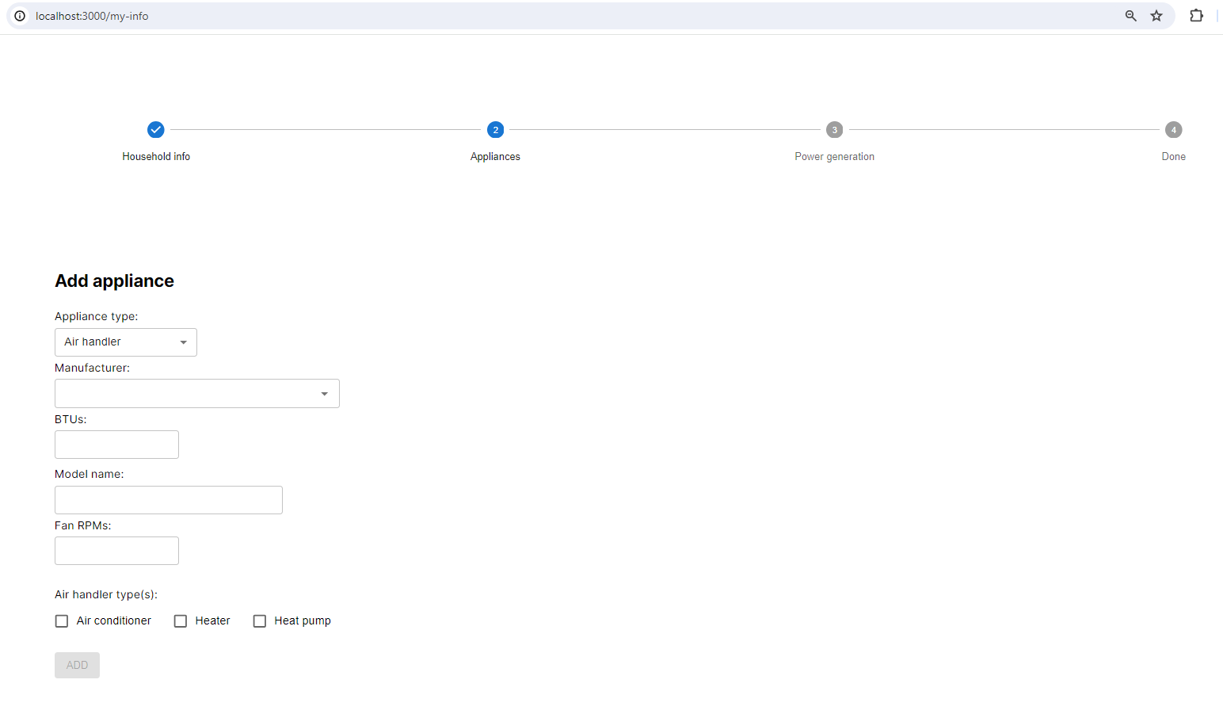

Slide 6
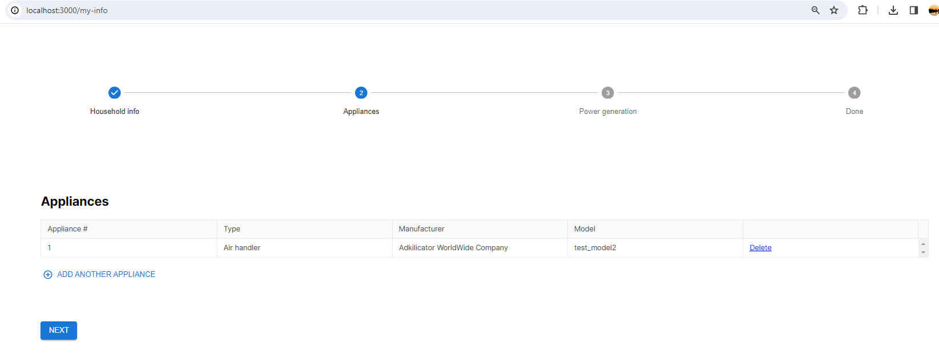

Slide 7
